Slide 1
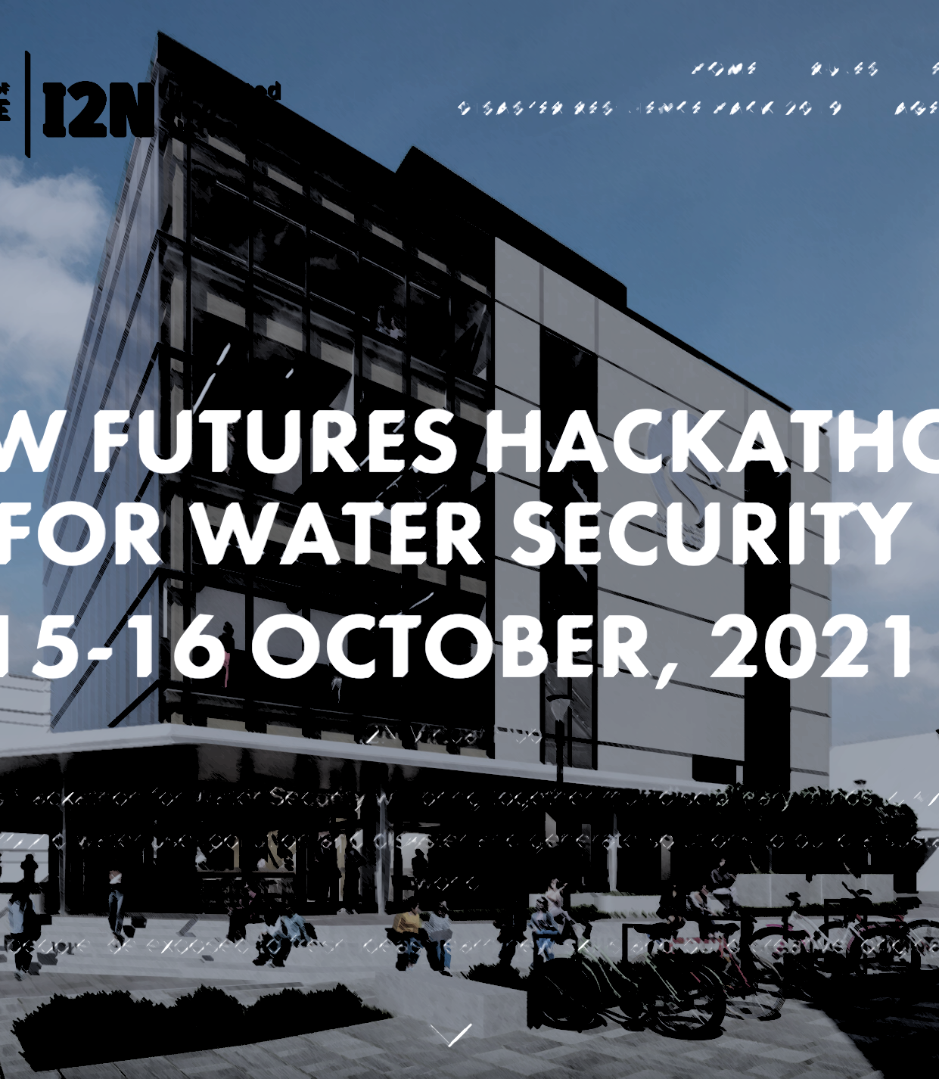
‘Cuddles
with
knives’
Travis Evan [UoN]
Mathew Halliday [UoN]
Mark Glease [UoN]
Indy Rendition [UoN]
Irene Perez-Lopez [UoN]

Slide 2


Slide 3
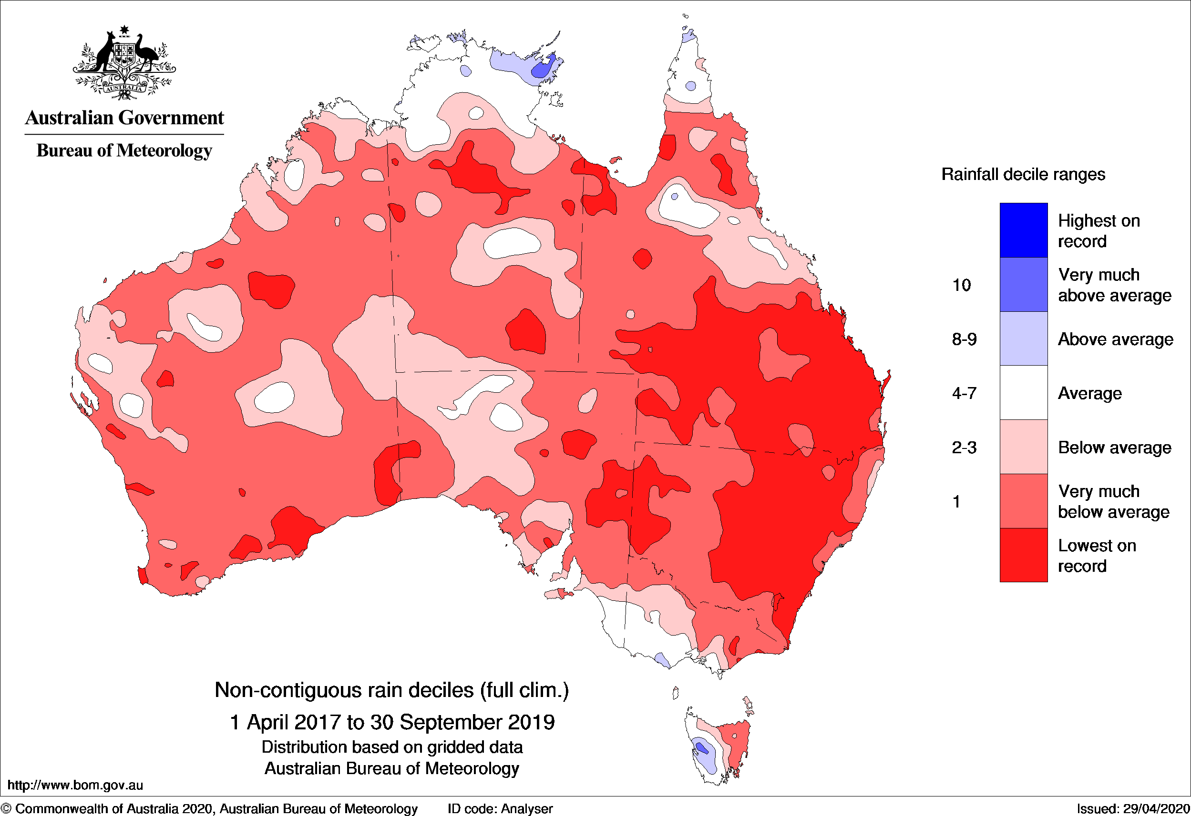
THE BIGGER PICTURE
How is Australia being affected?
What we asked ourselves:
Where to look / What to solve
When to solve it, why now?
Where is an effective location to reduce water waste?
http://www.bom.gov.au/climate/drought/knowledge-centre/previous-droughts.shtml
Recent droughts in Australia

Slide 4
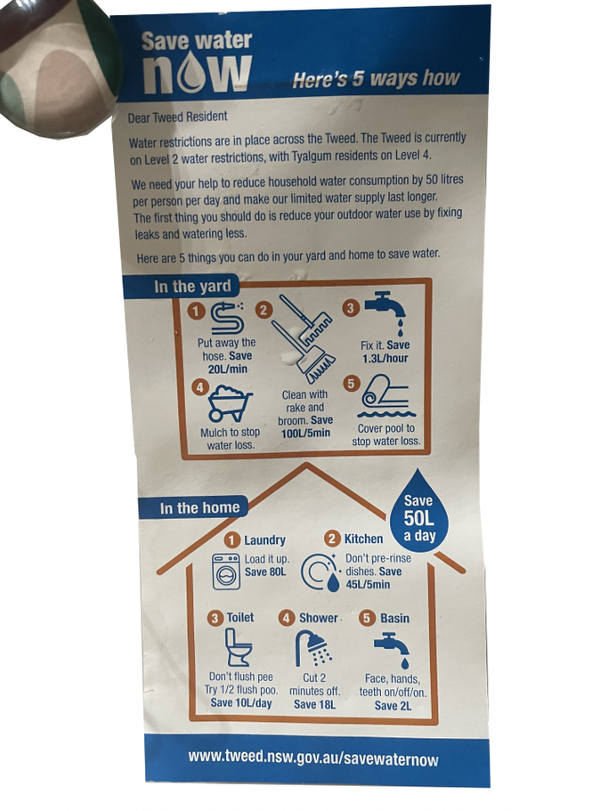
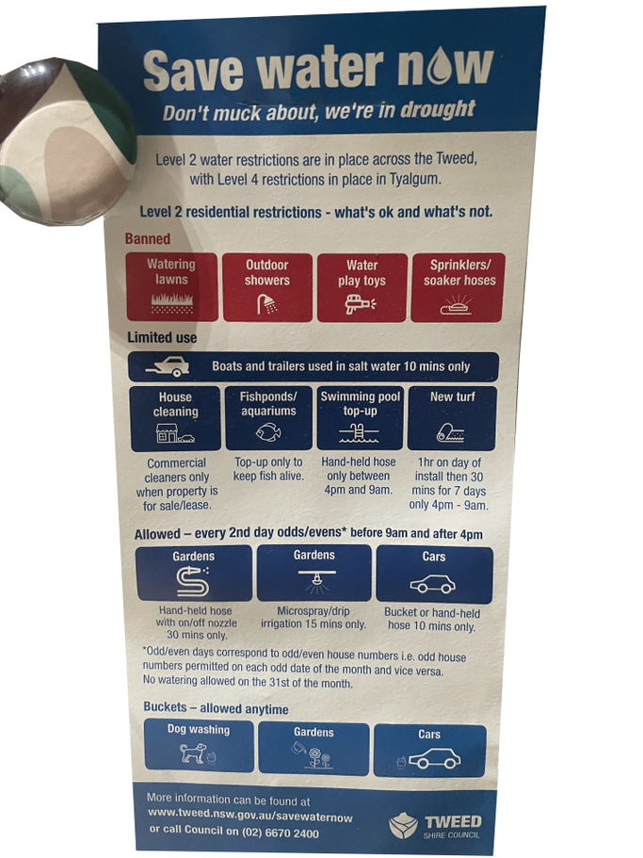
How can one interact with their water usage?
Is there existing analysed data?
Is there any way to find out more on saving water?
Who can I contact for my own water use, and improving it?
Notes:
WHY/GOAL: Relate water security/sustainability/climate change… Due to the unpredictable effect of climate change (floods & droughts periods more and more intense) water security is a major issue (salt acuiphers. & water bodies; pollution in river basin pass to water bodies and intense period of drought will be more severe and eventually common). Thus , ensure water security based on saving. Water. & community commitment. & education is more important than ever.
TARGETING COMMUNITY AWARENESS AND EDUCATION: Based on Hunter Water drought report, major saving will come from industry (add. Reference & quotation) but the project/app propose an application than can easily be adjusted to industry, although it target residential that is (again reference to report) a more difficult target in long terms.
SCHOOLS/CHILDEN EDUCATION AND APP OPERATIVITY: Bring to attention that app will be very. Easy to manage, almost manageable by kids. The. Idea is archiving consciousness and awareness by educating kids and adolescents. That then educate elder and parents in best practice. Also facilitating the App and making it work as a game more than as a “boring” tool.

Slide 5
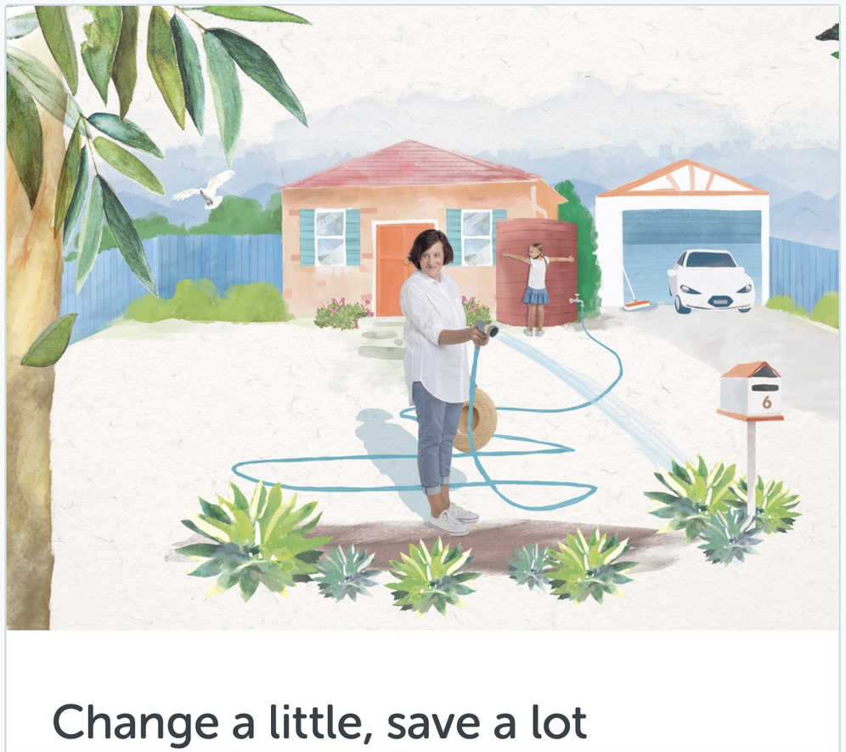
What is the importance of education?
Based on data from Hunter Water, the average household in Newcastle uses:
172 kilolitres (kL) of water each year,
or about 57 kL per billing cycle.
Average Water Costs in newcastle:​ Houses: $1155​ Units / Apartments: $1029​
Most people are unintentionally unaware of their ecological footprint, such as if they are waterwise or not.

Slide 6
Having information designed around you
We aim to:
Integrate with modern life through a universal app
Educate people through their own actual water use
Do it before a drought, instead of during one, and prepare for the increased drought frequency

Slide 7
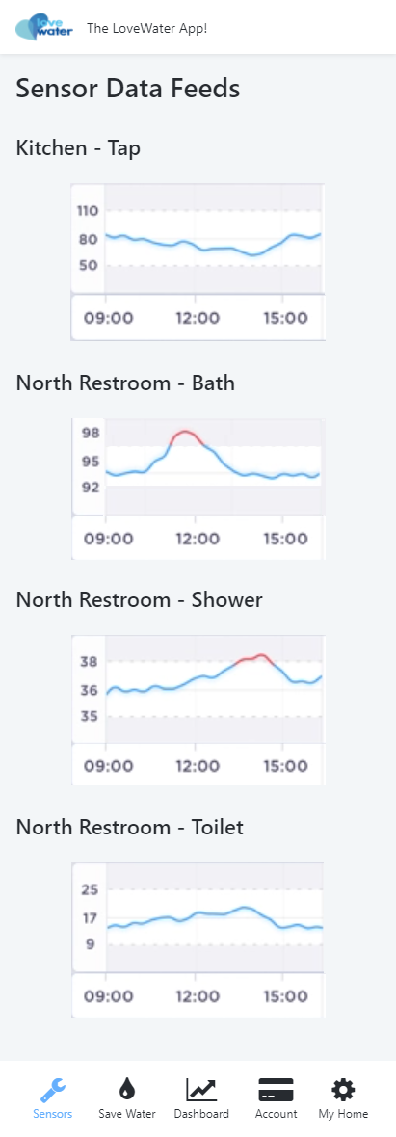
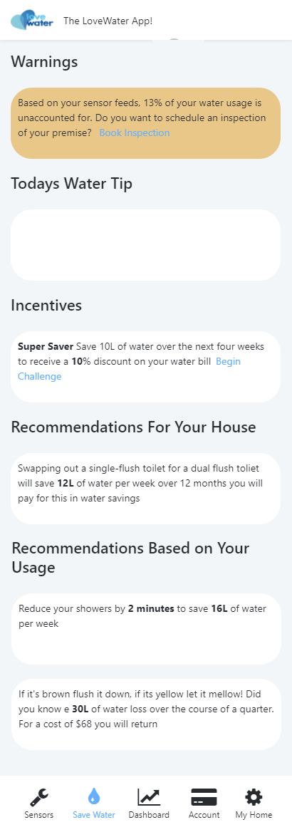
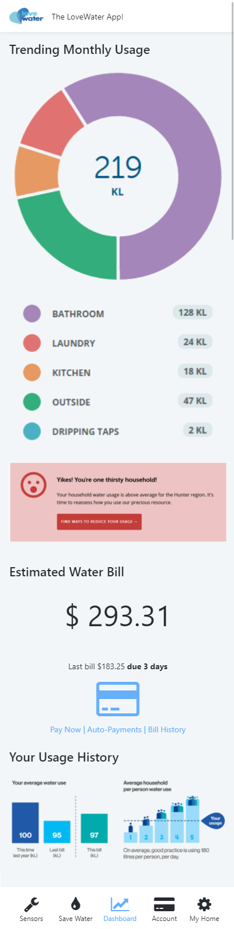
Proposal
Install methods
of monitoring water
Providing data to many parties, helping educate and spread data for free
Notes:
Saving water now (do not postpone our responsibility with the planet and water scarcity)
- Hunter water and many other cities worldwide already have a water meter… WHAT MAKE THE DIFFERENCE WITH THE APP? WHY. IS IMPORTANT?

Slide 8

How is this app different?
We are interactive, practical, and adaptable
Educate through reward
Allow interactivity between users and providers

Slide 9
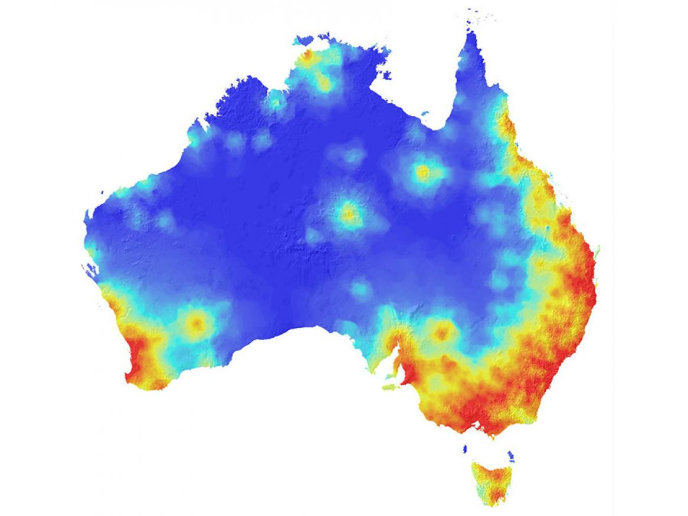
Who would use this?
Everyone is encouraged to be waterwise
From kids to elderly, everyone can learn and try new things
Hypothetical heatmap of water usage
Notes:
- START EXPLAIN THE architecture of the APP… / navigate through!

Slide 10
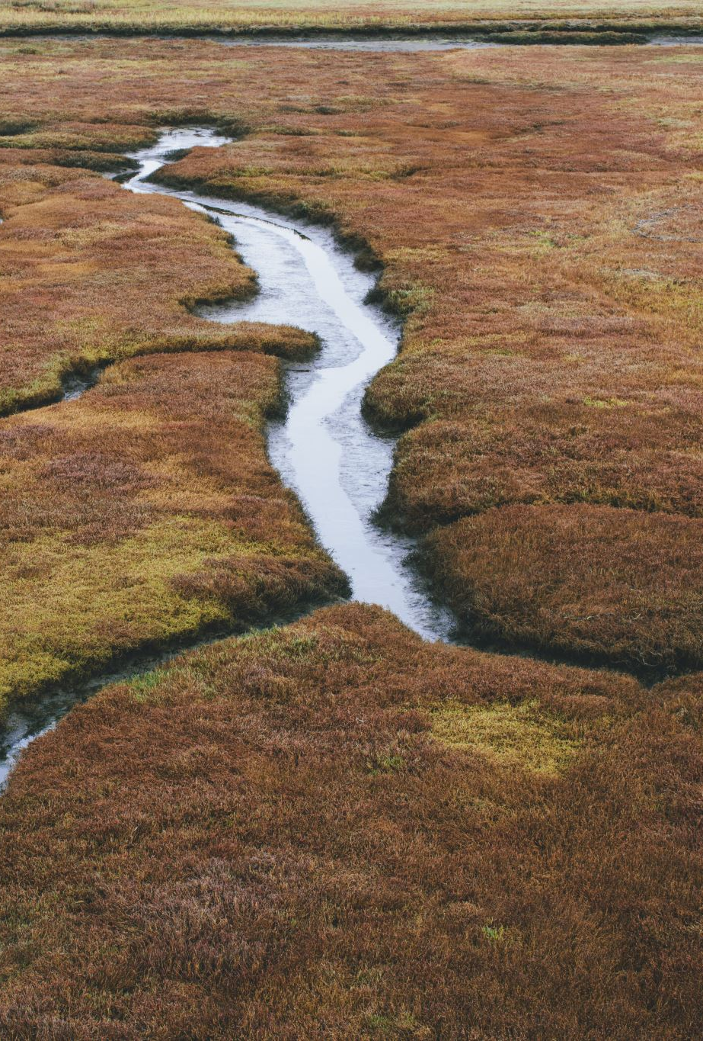
Let us help
Aussie water
Water efficiency: Supporting water that is managed efficiently, delivering maximum environmental and social benefit at least cost
Water performance: Effective measurement and reporting on water security to our community
Water sustainability: Supporting water that is managed within sustainable limits, delivering whole of water cycle outcomes
Water reliability: Supporting water supplies that are secure, resilient and deliver customer value.

Slide 11
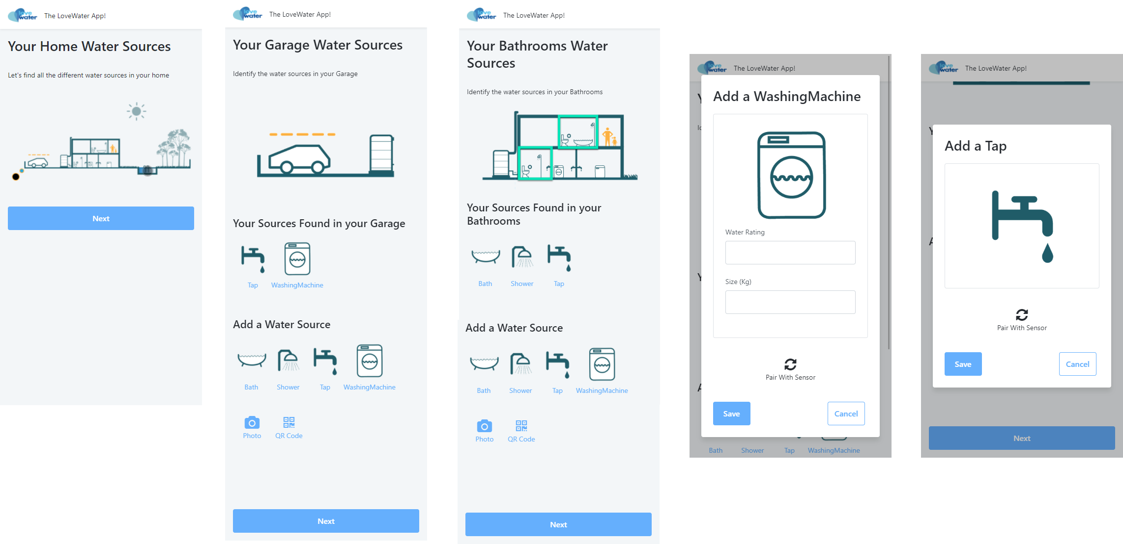
APP

